Slide 1

Prompt Crafters
Kandi Harish
Sahayak: AI-Powered Teaching AssistantEmpowering teachers in multi-grade classrooms

Slide 2

INTRODUCTION
Indian teachers regularly teach 2-4 grades in a classroom.
Schools that have limited personnel/resources face time constraints and have limited tools to create something relevant for the local context.
Students show wide variability in the ability to learn, so personalized learning is necessary.
Meaningfully engaging students requires culturally and linguistically appropriate content.
"Sahayak" is an AI-powered teaching assistant for teachers.

Slide 3

OBJECTIVE
To create a smart AI assistant called "Sahayak" to assist teachers who work in multi-grade, resource-poor settings, by also assisting with lesson plans, educational resources, and individualized instruction in the local language.

Slide 4

BACKSTORY :
Educational Reality: There are many remote educational facilities having very few teachers (often just one) teaching 3-4 grades simultaneously with no support staff.
Language Disconnect: Educational resources often use completely unfamiliar languages to students, which makes it worse because they cannot understand and engage.
Educator Workload: In many cases, if you are like us, it would likely take hours for educators to create relevant worksheets and lesson plans for every child at all 3-4 grades.
Technology Constraints: Educators can use a cloud but do not often have access to good hardware or reliable internet access on a consistent basis.
Authenticity in Design: We developed with the true needs of educators in India from a window based on our understanding of educational challenges and competition findings.

Slide 5

PROBLEM STATEMENT
Across India's under-resourced schools, teachers often face the difficult task of teaching multiple grade levels within the same class with limited time and resources needed to develop culturally relevant learning materials, address diverse learning needs and provide personalized learning for each student. Our goal is to build an authentic AI partner whose purpose is to alleviate their work burden and extend their education reach.

Slide 6
PROBLEM - SOLUTION MAPPING
Challenge | Sahayak's Response
Need for local language content | Advanced multilingual AI with cultural context
Creating different worksheets for each grade | Photo-to-worksheet generation using AI vision
Answering diverse student questions | Instant knowledge base in simple, local language
Making visual learning aids | AI-generated drawings and charts from descriptions
Assessing reading skills | Voice-based reading evaluation
Creating engaging activities | Automated educational game generation
Weekly lesson planning | AI-powered curriculum planning
Using Google AI technology | Full integration with Vertex AI and Firebase

Slide 7
OPPURTUNITIES
How different is it?
Unlike typical EdTech tools, Sahayak works offline (PWA), supports Indian languages, and accepts voice, text, and images to generate content.
How does it solve the problem?
By automating worksheet and lesson plan creation for each grade, in the teacher's preferred language, reducing manual effort and saving time.
USP (Unique Selling Proposition):
Multi-input (Text, Voice, Image)
Multilingual content generation
AI-powered visual aids and student reading assessment
Offline-ready for rural areas

Slide 8

LIST OF THE FEATURES OFFERED BY THE SOLUTION
AI-generated worksheets
(multi-grade)
Text, voice, image-based prompts
Lesson plans and quizzes
Visual aid/image generation
Reading assessment scoring
Multilingual support (Hindi, Telugu, Kannada, etc.)
Firebase Auth & content saving
Offline-first mobile-friendly interface

Slide 9

TECHNOLOGIES TO BE USED
Frontend: React Js
Backend: Next.js ,Firebase Functions
Database: Firestore
Authentication: Firebase Auth
AI Services: Vertex AI (Gemini Pro, Vision, Speech-to-Text)
Storage: Firebase Storage
Deployment: Firebase Hosting, Emulator Suite

Slide 10
METHODOLOGY
Research Phase:
Educator interviews to identify challenges in lesson planning and material creation is to be Analysed needs across differentiated multi-grade classrooms before the implementation.
System Workflow:
Educator authentication which included Firebase security
Task selection menu screen: worksheet creation, visuals, assessment, lesson planning
Multi-modal inputs: text description, image uploads, audio
Gemini API processes multi-modal inputs
Content delivery and storage through Firebase Functions and Storage platforms

Slide 11
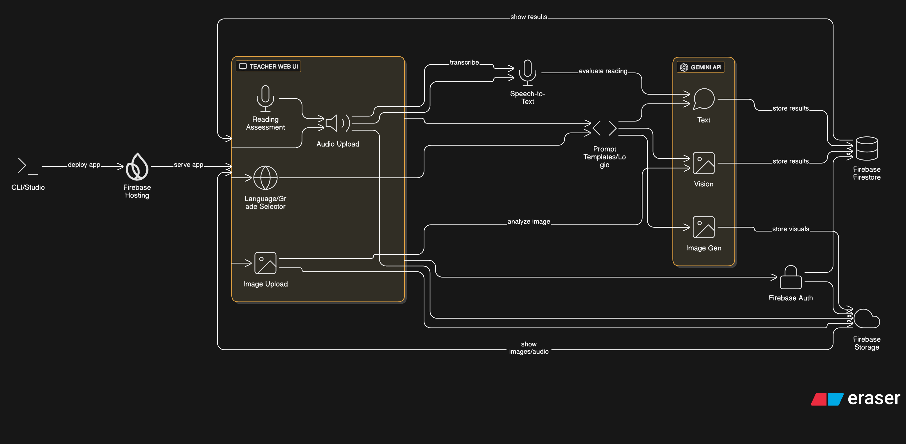
SINGLE PAGE ARCHITECTURE DIAGRAM

Slide 12
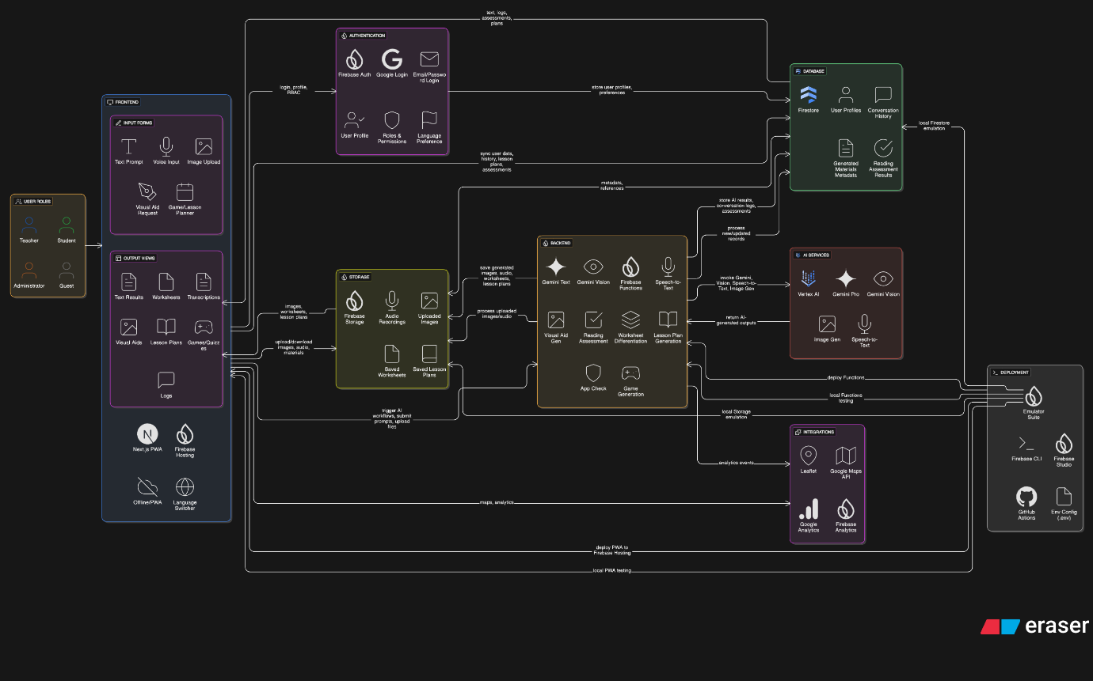
TECHNICAL & TOOLS ARCHITECTURE DIAGRAM

Slide 13
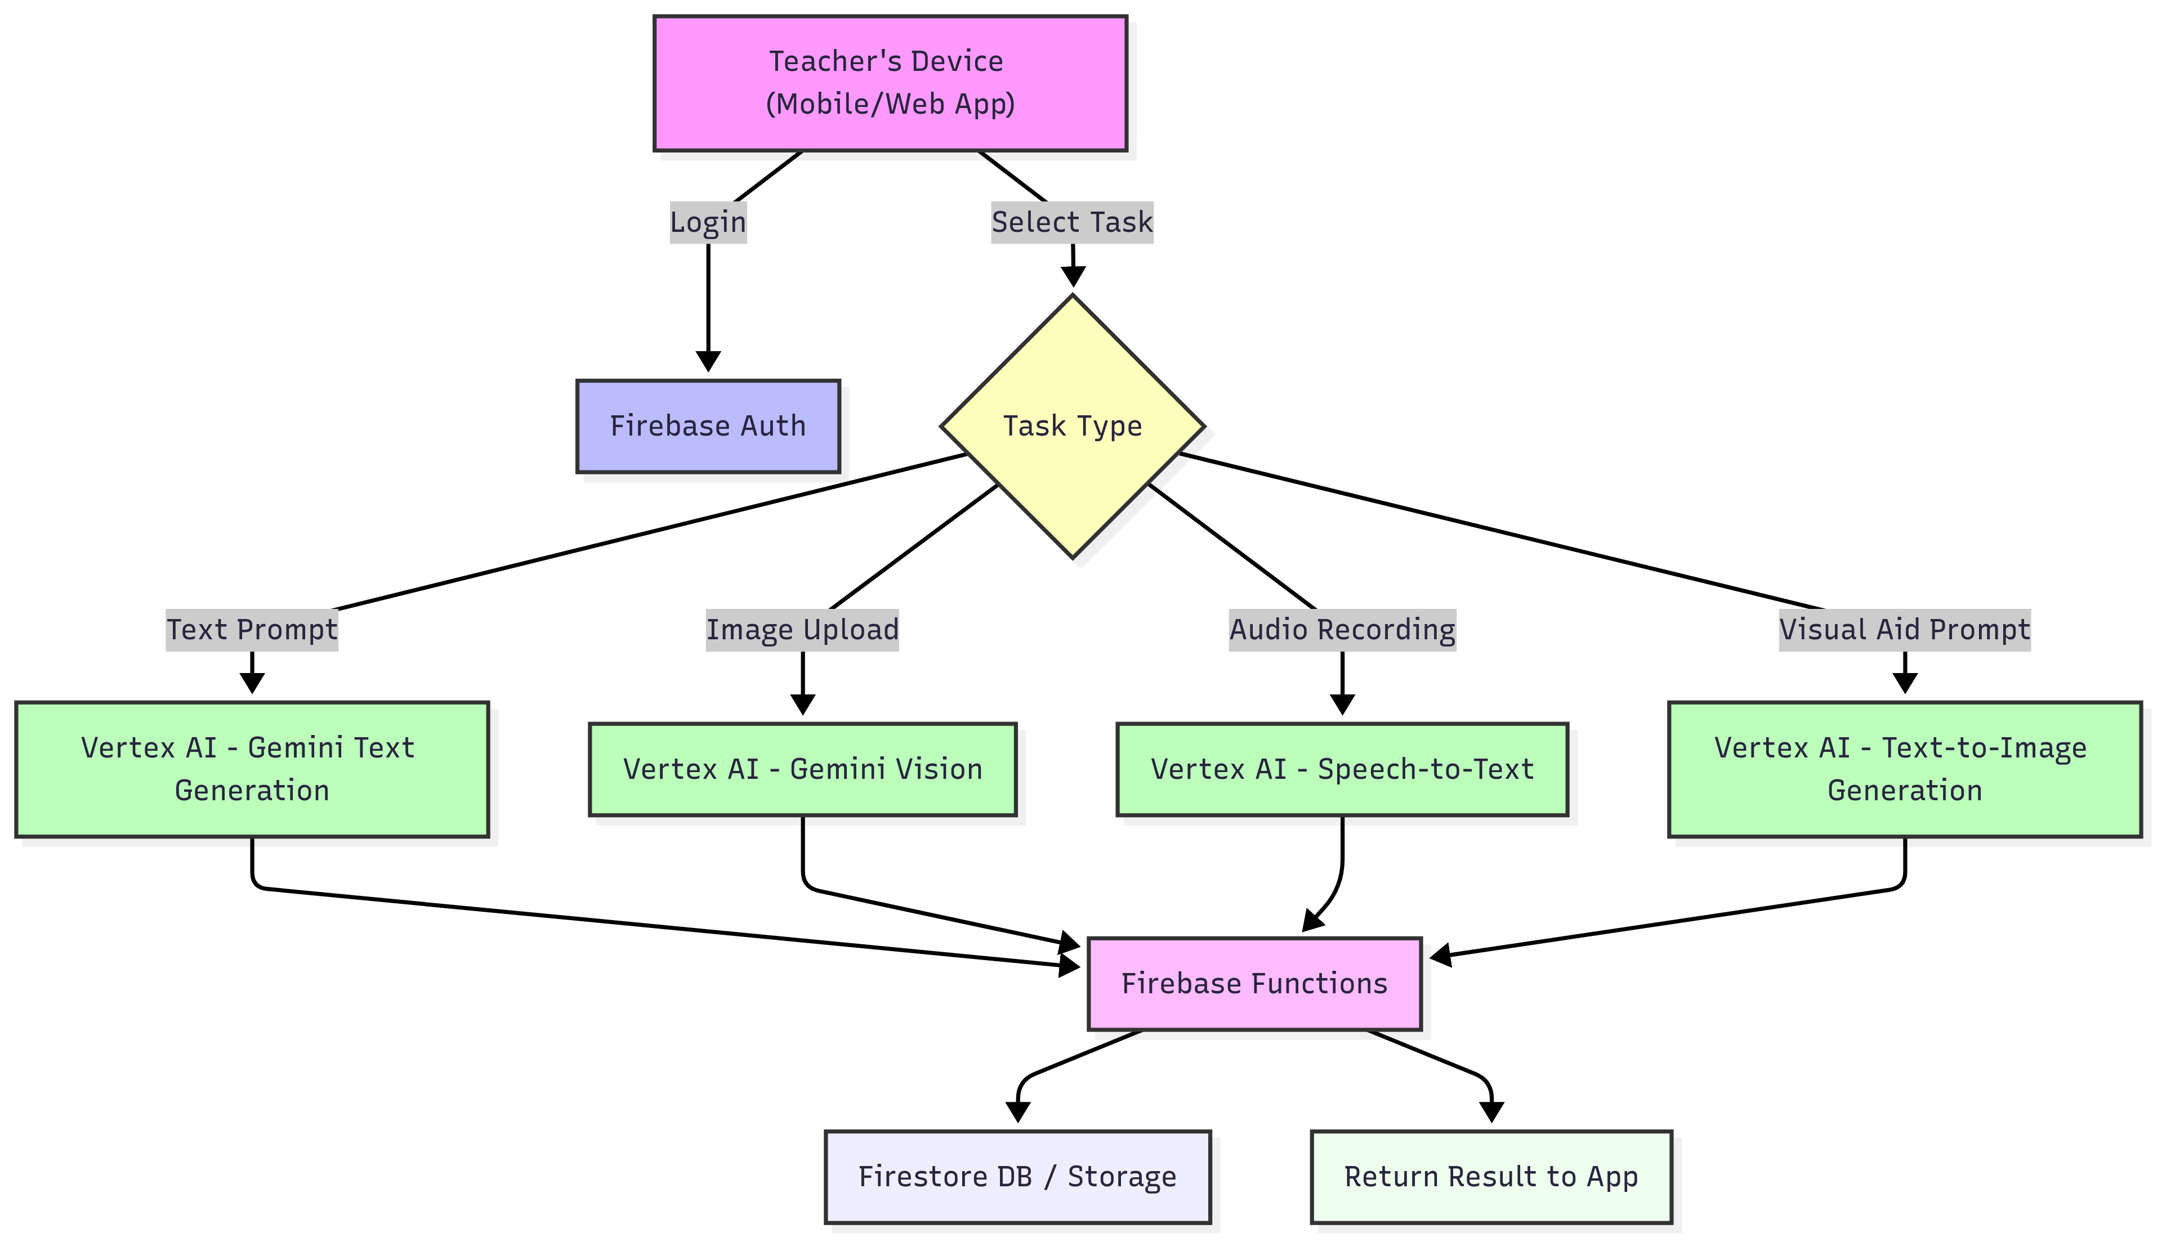
PROCESS FLOW DIAGRAM OR USE-CASE
Teacher logs in & selects language + grade
Chooses input: text / voice / image
Prompt sent to Gemini / Vertex AI via Firebase Functions
AI generates response → shown as worksheet, lesson plan, image, etc.
Teacher saves/downloads content

Slide 14

IMPACT
Substantially reduces the amount of time educators need to see preparation
Provides equitable learning possibilities in all grade levels
Promotes linguistically and culturally diverse education approaches
Offers high-level AI availability to school with limited resourcing
Provides more innovative engagement and improved student achievement

Slide 15
REFERENCES
Research Foundation – 2024 Publications:
Shaham, N., Liu, X., Liperoti, M., Khadgaray, M., & Bar-Haim, U. (2024). Multilingual Instruction Tuning With Just a Bit of Multilinguality. ACL Findings 2024.
Lin, Z., Wang, C., Yin, L. Bai, Y., & Zhang, Y. (2024). Prompt-to-Image-to-Text: Regularising Multimodal Reasoning Via Cyclic Generation. ACL 2024.
Indurthi, S., Liu, X., Biagetti, M., Prain, A., Tan, B. S. T., & Wang, N.-X. (2024). Improving Multilingual Instruction Finetuning via Linguistically Natural and Diverse Datasets.
Wang, Z., Wu, Y., Liu, S., Huang, K., Wu, G., & Wu, T.-L. (2024). Unified Multimodal Instruction Tuning for Vision-Language Models. CVPR 2024.
Tariq, M., Peddalas, K., Perera, S., & Chennupati, R. (2024). Multilingual Whisper: Large-Scale Speech Recognition in over 100 languages.

Slide 16
